Slide 1
Explainable Reasoning over Knowledge Graphs for Recommendation
Xiang Wang, DingxianWang, Canran Xu, Xiangnan He, Yixin Cao,
Tat-Seng Chua
(AAAI-2019)
吳伯遠

Slide 2
Introduction
Incorporating knowledge graph into recommender systems has attracted increasing attention in recent years.
The connection between users and items can be discovered as paths.
The paths can provide rich and complementary information to user-item interactions.

Slide 3
Introduction
The paper proposed a new model named Knowledge-aware Path Recurrent Network (KPRN) to exploit knowledge graph for recommendation.
Generate path representations by composing the semantics of both entities and relations.
A new weighted pooling operation to discriminate the strengths of different paths in connecting a user with an item.

Slide 4
Model Introduction
The model first extract qualified paths between a user-item pair from the KG.
Adopt LSTM network to model the sequential dependencies of entities and relations.
Thereafter, a pooling operation is performed to aggregate the representations of paths to obtain prediction signal for the user-item pair.

Slide 5
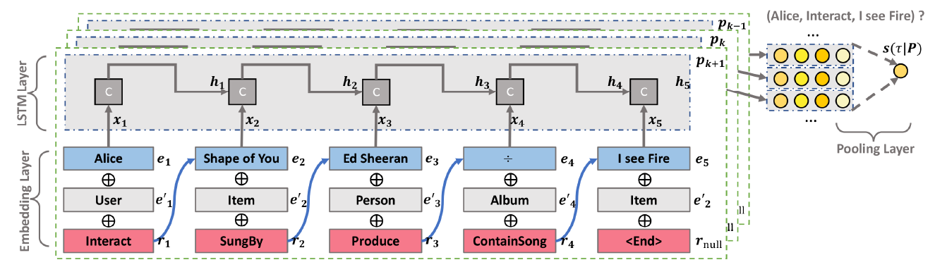
Model Architecture
3
2
1

Slide 6
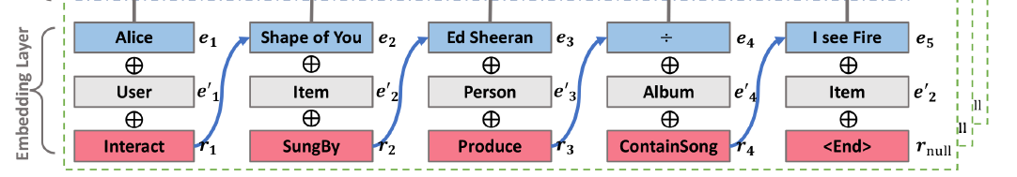
Model Architecture - 1
Embedding layer to project three types of IDs information: the entity, entity type, and the relation pointing to the next node into a latent space

Slide 7
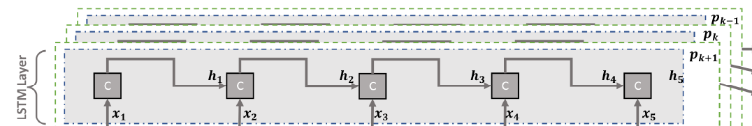
Model Architecture - 2
LSTM layer that encodes the elements sequentially with the goal of capturing the compositional semantics of entities conditioned on relations.

Slide 8
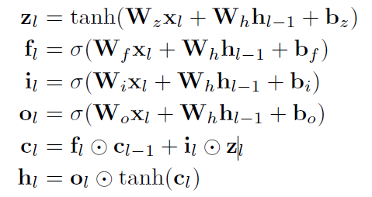














Model Architecture - 2
$$h_{l}$$
$$C_{l-1}$$
x
+
$$C_{l}$$
$$C_{l}$$
tanh
$$f_{l}$$
x
$$o_{l}$$
$$i_{l}$$
x
$$z_{l}$$
$$σ$$
$$σ$$
tanh
$$σ$$
$$h_{l-1}$$
$$h_{l}$$
$$X_{l}$$

Slide 9
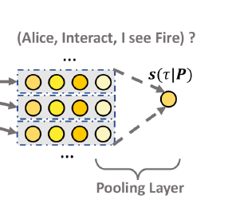
Model Architecture - 3
Pooling layer to combine multiple paths and output the final score of the given user interacting the target item.

Slide 10
Experiment
MI datasets:
The combination of MovieLens-1M and IMDb datasets, which are linked by the titles and release dates of movies.
MovieLens-1M offers the user-item interaction data
IMDb serves as the KG part that contains auxiliary information on movies Ex.(genre, actor, director and writer)

Slide 11
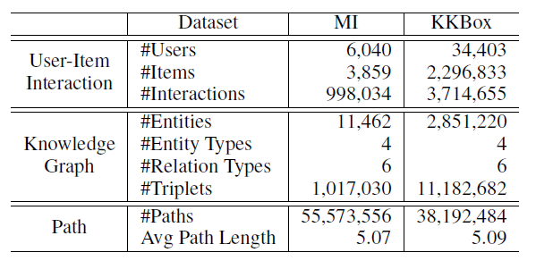
Experiment
KKBox datasets:
The datasets contain the user-item interaction data
Also the description of music like singer, songwriter and genre.

Slide 12
Experiment
Evaluation Metrics:
hit@K : considers whether the relevant items are retrieved within the top K positions of the recommendation list.
ndcg@K : measures the relative orders among positive and negative items within the top K of the ranking list.

Slide 13
Experiment
MF : Matrix factorization with Bayesian personalized ranking (BPR)
NFM : Neural Factorization Machines
CKE : Collaborative Knowledge Base Embedding for Recommender Systems.
FMG : Meta-Graph Based Recommendation Fusion over Heterogeneous Information Networks.
Notes:
MF : 貝葉斯個人化排名做矩陣分解。
NFM : . Which treats historical items as the features of users.

Slide 14
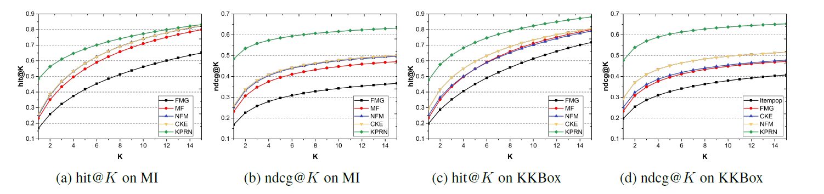
Experiment
FMG gives poor performance in both datasets.
NFM achieves better performance than MF.
CKE perform second best in the experiment.
Notes:
FMG 是 meta-graph based方法，這個方法很依靠事先定義的meta-graph pattern. 他找出來的可能都是關係比較遠的entity而且沒辦法找出完整的user-item的互動。
MF和NFM都是CF based的方法，NFM 實質上加強了找到第二成的關係, 而MF只考慮第一層的user-item關係。
CKE的效率證明了knowledge graph可以有效率的解決資料稀疏的問題。在MI表現較還好，但在kkbox極度稀疏的資料上表現就還好。

Slide 15
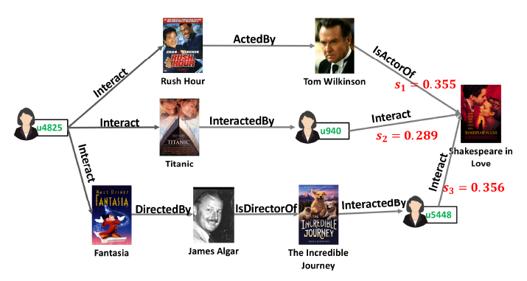
Experiment
Randomly select a user, whose ID is u4825 in MovieLens-1M, and select the movie Shakespeare in Love from her interaction record.
Extract all the qualified paths connecting the user-item pair

Slide 16
Experiment
Collaborative filtering effect plays a pivotal rule to recommend the movie Shakespeare in Love to the user.
The target item is connected to what u4825 has watched before shows that KPRN is capable of extending user interests along KG paths.
Different paths describe the user-item connectivity from dissimilar angles. We can offer path-wise explanations.

Slide 17
Feedback

